Slide 1
2025 Mid-Year Budget Amendment
Intercity Transit Authority Board
June 18, 2025
Notes:
Introduce self

Slide 2
Budget Year-to-Date
Resources Available to Provide Services
Notes:
Resources Available to provide our community’s transformational services.
Beginning Balance came in 6.7 M more than anticipated
The bulk of “other revenues” is interest income we earn on our reserves. As of 5/31 we have earned 3.2 M, over 60% of what was budgeted.
The remaining other revenues are credit card rebates, insurance recoveries, and shared funding for our Centennial Amtrak station.
Other Agency Revenues represents Sales Tax and Grants. Sales tax numbers are flat, however we are right on target with what was conservatively budgeted. Grants come in behind due to timing

Slide 3
Expenditure Budget Year-to-Date
Notes:
We are 42% through the fiscal year and expenditures are low
Capital
Administrative Services is the software
Development has some projects budgeted but most likely won’t be spent due to funding
Maintenance & Facilities provides budget capacity for ordering, however dollars spent will be delayed 12 to 18 months.
Point out the budgeted ending balance is set to 221,445,381 and we come back to this

Slide 4
Proposed Budget Changes
Professional Service Change Needs:
  Ongoing legal services related to outstanding and anticipated employment issues, and
  Legal costs due to the recent actions of the Federal Transit Administration (FTA) orders potentially jeopardizing our federal grant funding.
Notes:
Employment issues - $50 K
FTA orders - $25 K

Slide 5
Proposed Budget Changes Con’t
Salaries and Benefit Change Needs:
  Ratification of the Amalgamated Transit Union (ATU) 2025-2027 contract,
  Staffing changes due to separations, retirements and new hires,
  Agency wellness benefit and change to supplemental retirement contributions, and
  Utilization of contingency in the 2025 budget for what-was the anticipated ATU contract settlement.
  Additional staffing resource needs.
Notes:
Contract $3.7 M
Staffing $ 3.1 M
Matching and WB - 668 K
Actual reconciliation staffing changes – (310 K ) savings
Utilize contingency - (500K) savings

Slide 6
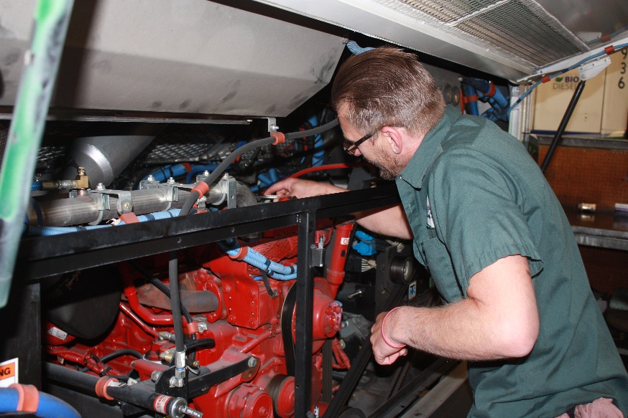
Staffing Needs
20 Coach Operators
4 Fleet Technicians and 1 Fleet Supervisor
2 Inventory Specialists
1 Administrative Assistant
1 Human Resource (HR) Analyst
0.5 Walk N Roll Program Representative
1 Walk N Roll Program Representative and 0.5 Program Assistant
Total of 31 Full Time Employees (FTEs)
Notes:
20 Coach Operators: Adds capacity to provide continuity during periods of hiring, training, and workforce transitions while also supporting a healthy and sustainable work environment for frontline staff.
4 Fleet Technicians: to accommodate an additional 28% increase in service, this is to expand graveyard shift coverage to a full 24/7 schedule from Wednesday to Saturday. This adjustment will ensure the Fleet Division is always on-site, providing continuous support to Operations while buses are in service 7 days per week.
1 Fleet Maintenance Supervisor: This position will ensure essential oversight of the expanded maintenance support
2 Inventory Specialists: This request aims to strengthen support for the expanding Facilities and Fleet divisions by increasing capacity for parts and service research, order processing, and delivery. It will also extend coverage into evening and night shifts to ensure seamless operations of the Inventory Division.
1 Administrative Assistant: The Executive Department has been utilizing temporary staff to help manage workload demands as we continue to experience increased public records requests and support needs. Given the long-term necessity and the role's ongoing presence, there is a strong interest in transitioning this into a permanent position.
1 Human Resource (HR) Analyst: Last year, the agency established a Sr. HR Analyst position to lead the development of its workforce development program. However, ongoing recruitment demands have delayed progress in this area. To address this, the new HR Analyst role will be dedicated to recruitment, including community outreach, directly supporting the agency's service delivery goals and enabling workforce development initiatives to move forward.
0.5 Walk N Roll Program Representative: Our part-time Bicycle Community Challenge Representative is retiring. Currently a seasonal role, this position operates for seven months each year. We are requesting the position transition to a full-time, year-round role. This expanded position will retain the responsibilities of the Bicycle Community Challenge Representative while incorporating additional programmatic duties with Walk N Roll growth.
1 Walk N Roll Program Representative and 0.5 Assistant: Walk N Roll was awarded a 2025-26 Youth Development grant from Cascade Bicycle Club. This is the second year of receiving this grant. The 2025-26 grant includes an addition of 1.5 FTE. The additional staff will allow Walk N Roll to expand the Teens Biking to Destinations Program to more of Intercity Transit’s service area and serve more youth. These positions are 100% grant funded.

Slide 7
Additional Budget Capacity Requested
Notes:
In Summary these changes result in an increase of $6,800,935

Slide 8
Final Budget with Amendment Resolution

Slide 9
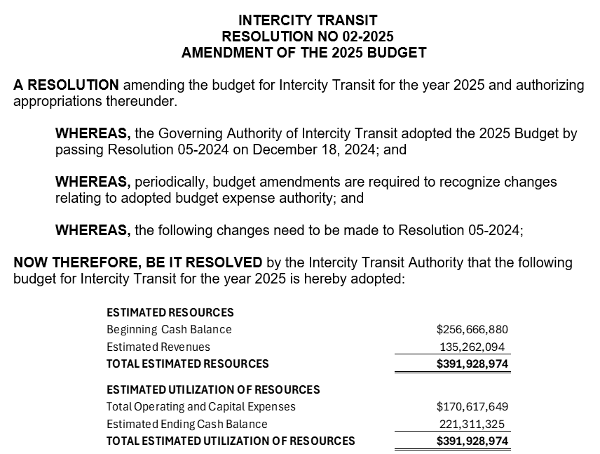
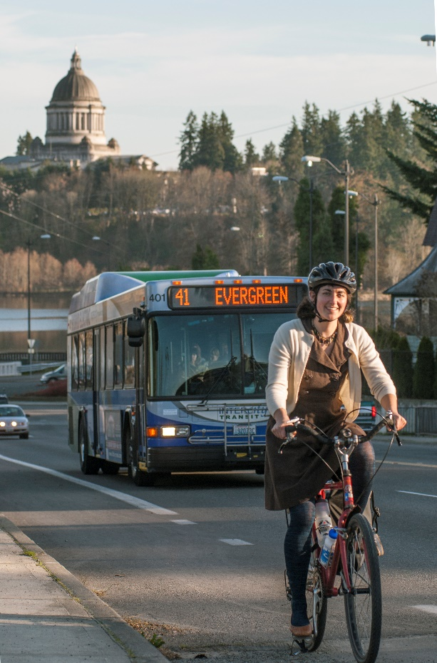
Amend 2025 Budget via Resolution

